Slide 1
Organization Name :
VMware Software India Pvt
Problem Statement :
Talking Fingers
Team Name : Pepehands
Team Leader Name :
Harshit Rai
AICTE Code : 1-3508354456

Slide 2
IDEA DESCRIPTION
The two major features of the Talking Finger mobile application are :
Real-time Text to Sign Language Translation
Real-time Sign Language to Text Translation
2. Text to Sign Language Translation
The application accepts the input text supplied by the user.
This text is then translated into English language to achieve high precision and translation accuracy.
If the entered text is an alphabet, it is mapped directly to the corresponding gesture.
If the text is a phrase, the most important features of the text are extracted using Natural Language Processing.
These extracted features are then mapped to the nearest gestures.
The mapped gestures are then displayed to the user.

Slide 3
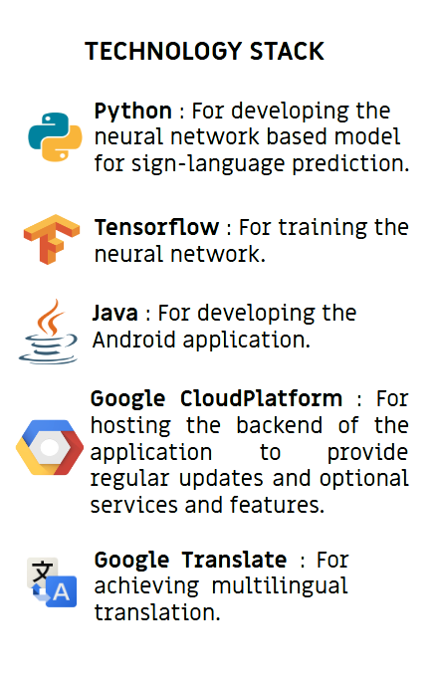
3. Sign Language to Text Translation
a. The gestures are captured using the mobile camera.
b. These gestures are identified and classified using the Object
Detection technique and Deep Neural Network.
c. The identified gestures are then mapped to their corresponding
labels.
d. The above three steps are repeated iteratively to form
meaningful phrases which will be finally displayed to the user.
TECHNOLOGY STACK

Slide 4
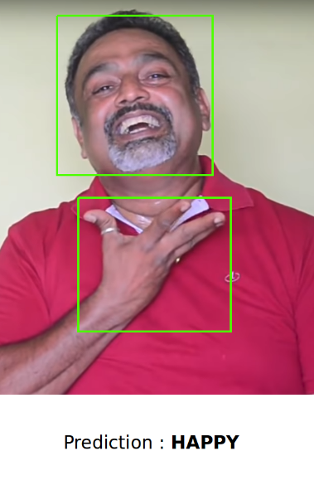
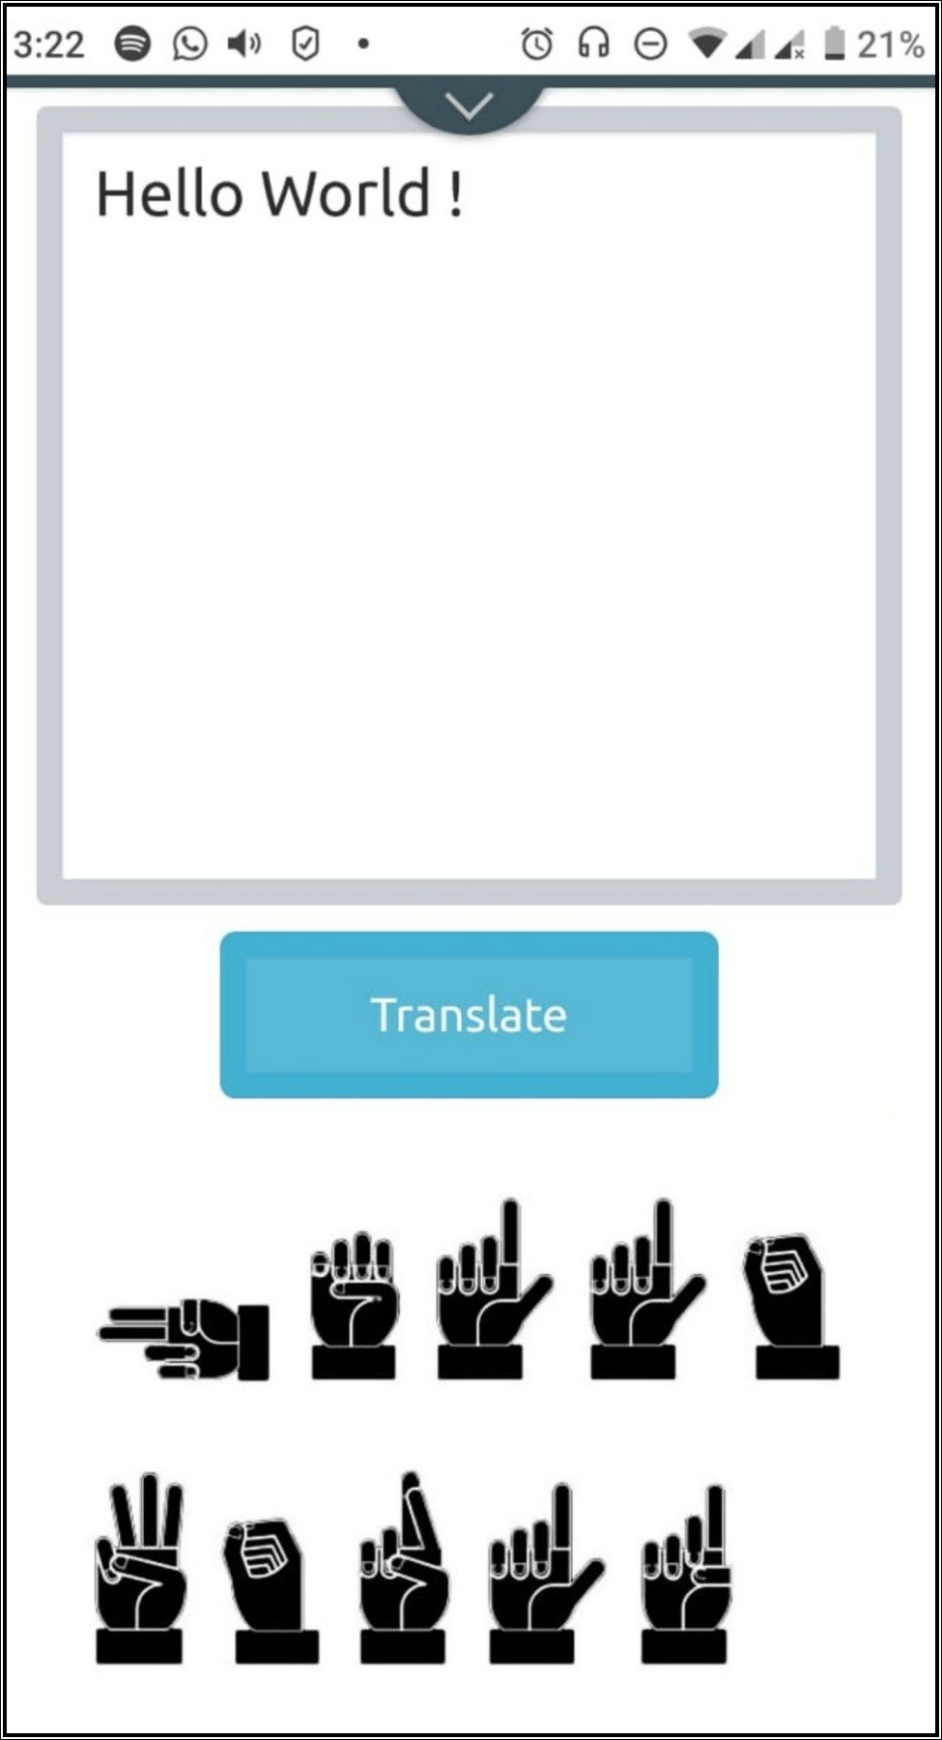
Sign Language to Text Translation
Using the Object Detection Technique and Deep Neural Network.
Place your screenshot here
Text to Sign Language Translation
Using Natural Language Processing and offline Google Translator.

Slide 5






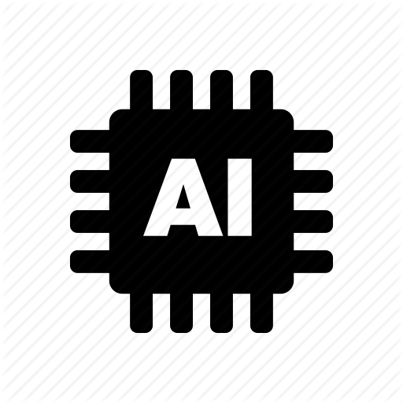
USE CASES
SHOW STOPPERS
1. Real-time processing of user data
2. Works offline post-installation
3. Bidirectional Translation (Sign Language to
text as well as Text to Sign Language)
4. Powered by the ‘State of the Art’ technologies
The “Talking Finger” Mobile Application can be used :
By educational institutes to train individuals with speech & hearing impairment.
2. By employees (facing speech & hearing impairment)
working in malls, restaurants, etc.
For improving the quality of conversation (with
speech & hearing impaired individuals) in general.
4. For eliminating the problem of unavailability of
interpreters.

